Slide 1







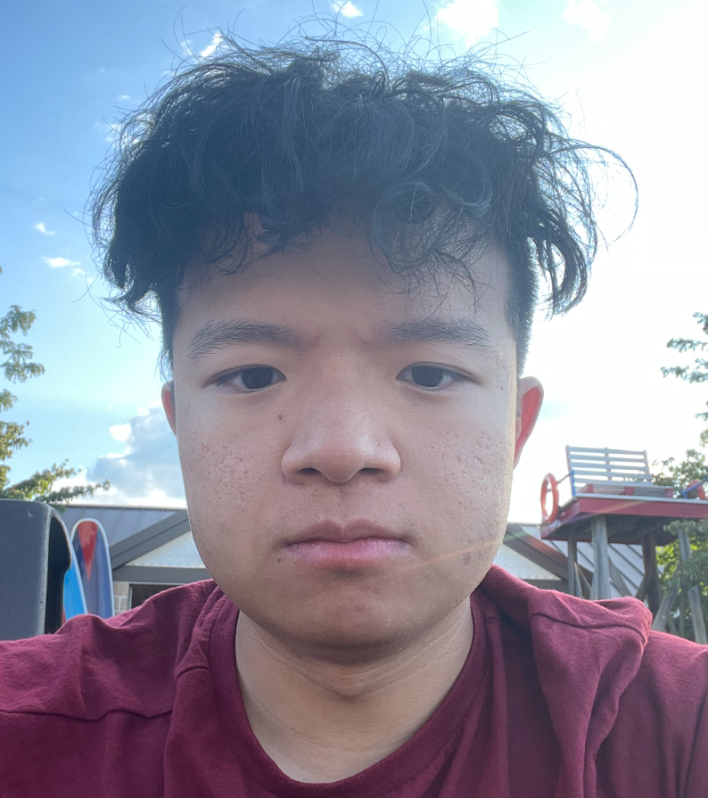
Outdoor AR Navigation
Project Statement:
RERC on AAC (Rehabilitation Engineering Research Center on Augmentative and Alternative Communication)
A collaborative center committed to advancing knowledge and producing innovative engineering solutions in augmentative and alternative communication (AAC) to improve outcomes for children and adults with both developmental and acquired disabilities.
In ongoing research efforts, they want to develop tools to integrate augmented reality into GPS navigation for day-to-day use in local devices (i.e., phones, tablets).
RERC on AAC's goal is to develop a custom app to navigate in the outside world through augmented reality on tablets and smartphones.
Our team:
Jahson Gonzalez-Allie Bingsong Yu Walter Morazan
Rashid Alshurafa Avish Shakwala s Amaan Barmare Ethan Fan

Slide 2
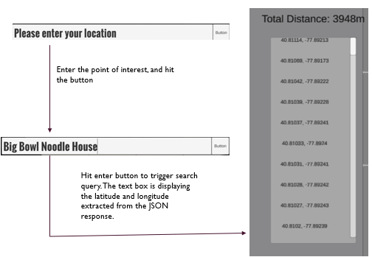
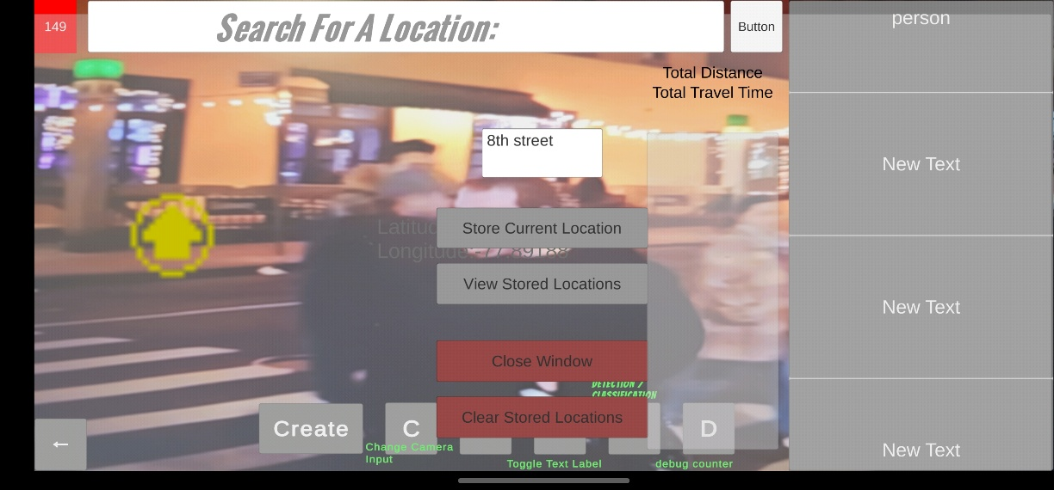
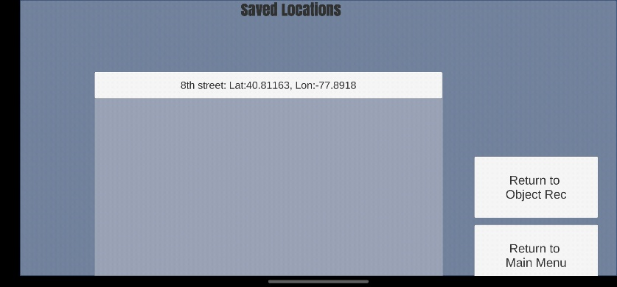
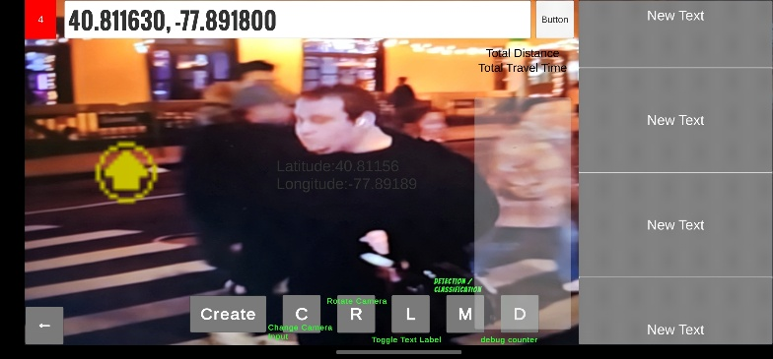
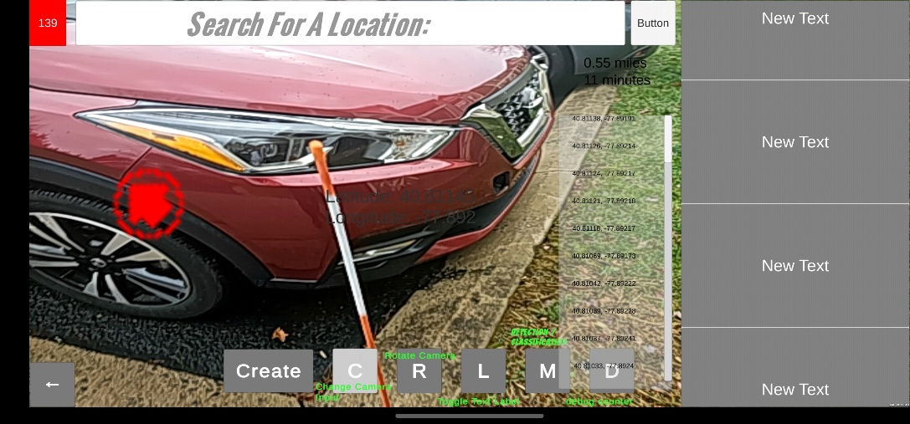
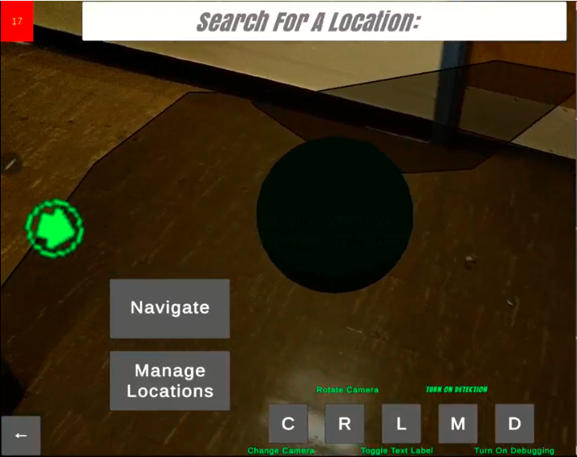
Design Process
Press Create button to store a new point of interest. Then, press Store button to store the location.
The stored location can also be accessed in this scene. you can
press the Entry to go back to the navigation scene, with the point of
interest parsed to the search bar.
The stored point of interest is parsed as coordinates back to navigation scene. You can also search a point of interest by it’s name, then to trigger the navigation, you need to click the button on the right.
Saving and loading point of interest User can store their location with a customized text, user can also load this point of interest.
Directions Convert the user input as text to coordinates by searching in radius of 10,000 meters.
Depth Sensing and Location Tracking
Maps position into a virtual space
Virtual space has markers, mapped back to camera view
Allows user to see markers and where to go next/avoid
Directional Arrows assist user in navigation
Points towards the next green marker
Avoids obstacles, marked by red markers
Each marker resembles a latitude/longitude point in the real world
If the virtual space detects there was an obstacle, the arrow would avoid the obstacle and look for ways to pass the obstacle. In this case, the arrow suggests we go left to avoid the obstacle.

Slide 3
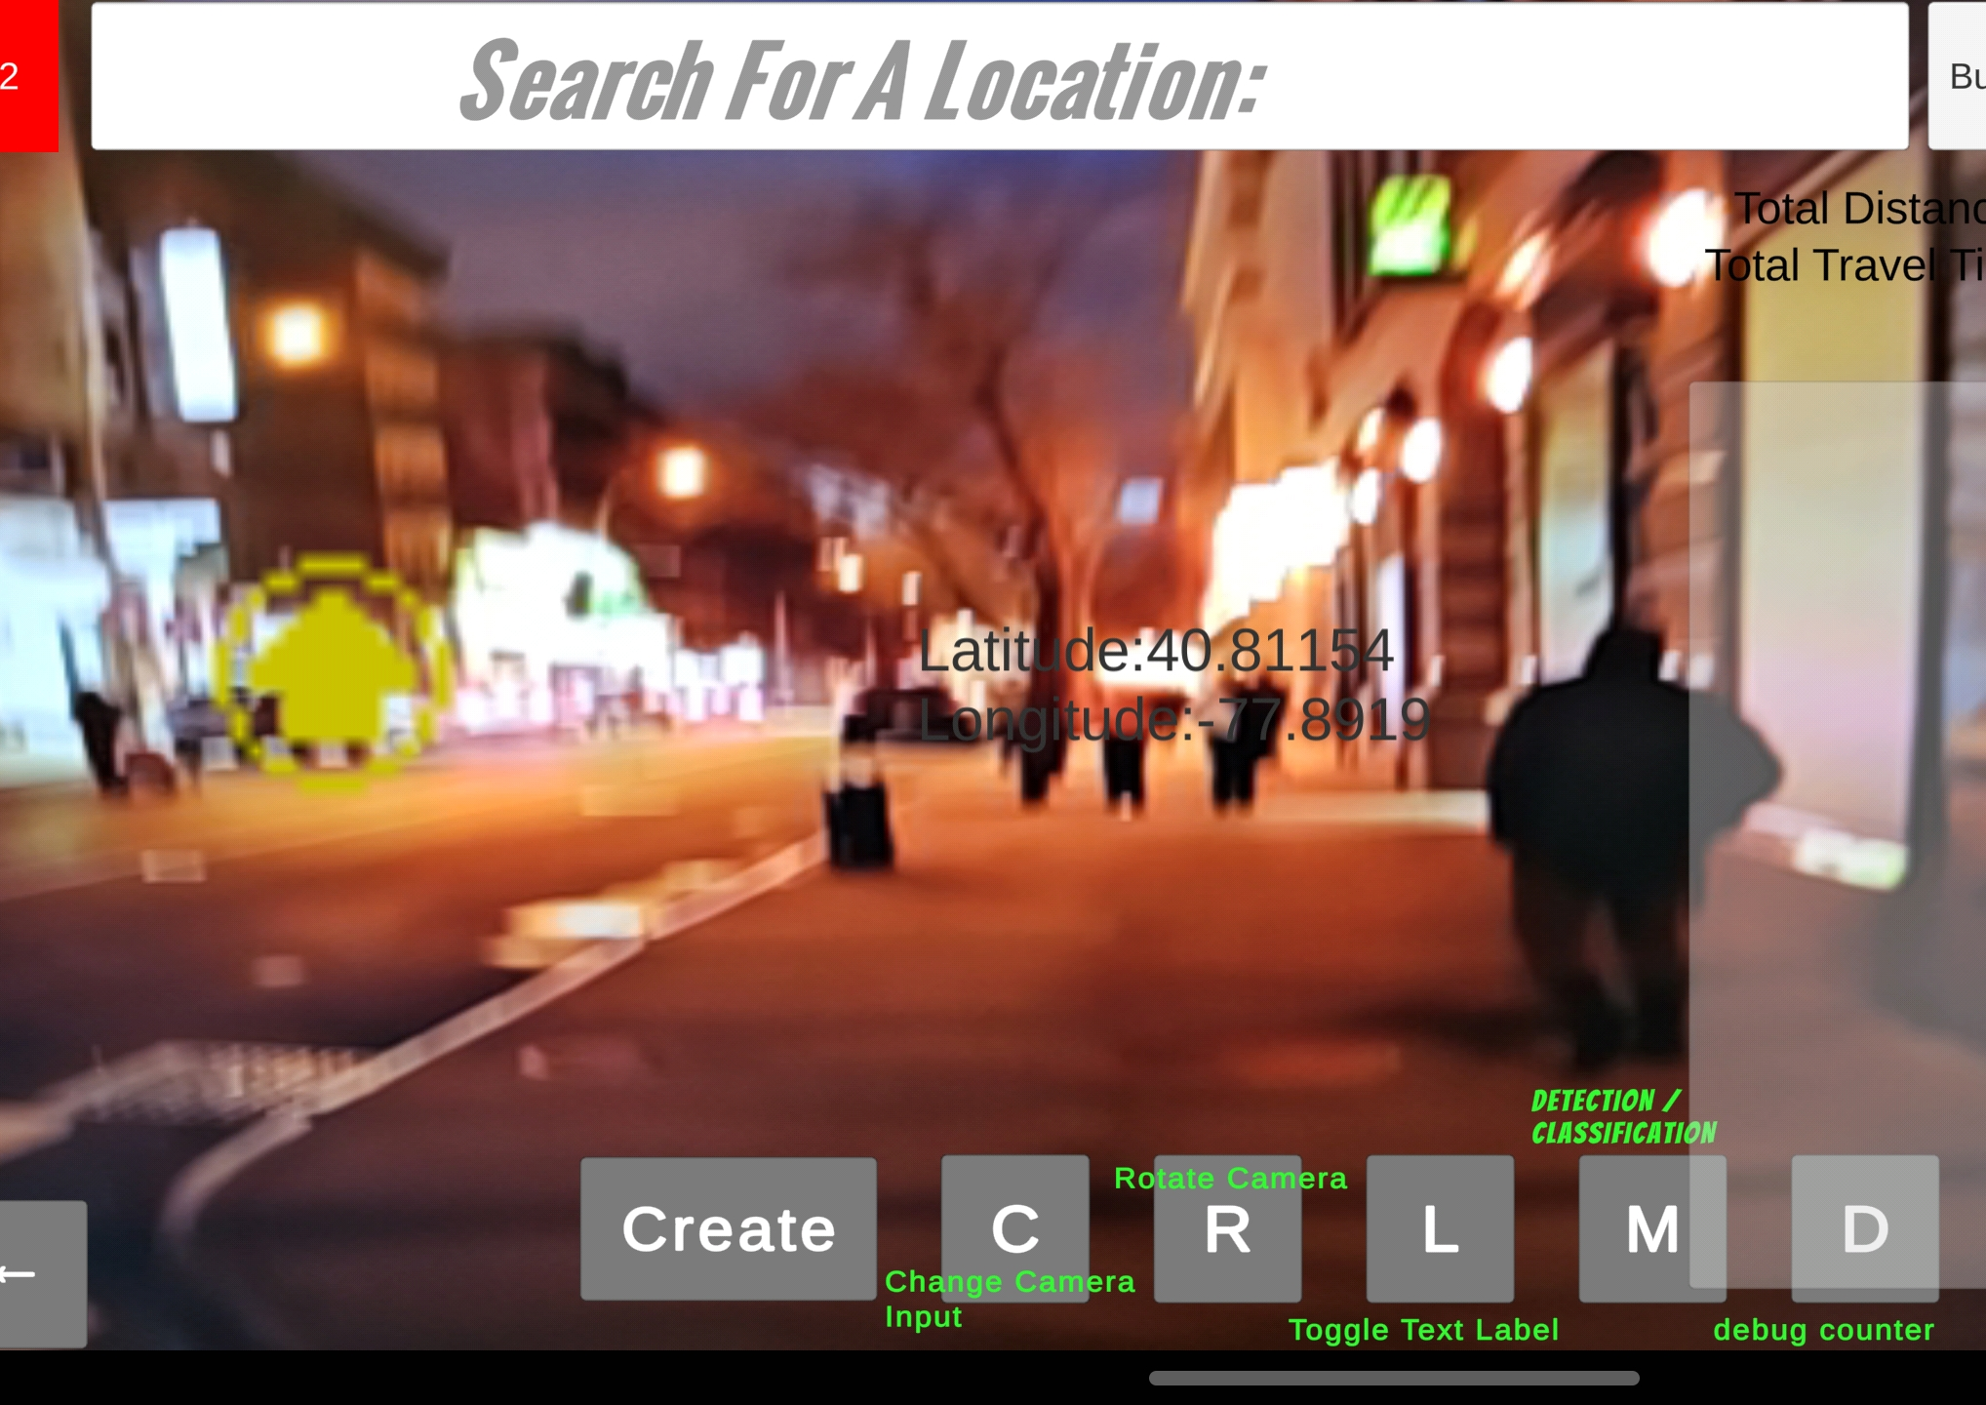
End Result
Our team designed an application that combines the ability to navigate, avoid obstacles, saves the point of interest and load the point of interest.

